Slide 1
2020 MSoC Final Project Presentation
Team 17
Github:
https://github.com/R09943156/MSOC/tree/main/final

Slide 2
Outline
Problem Formulation
(Discrete) Fractional Fourier Transform
Algorithm Simulation
Hardware Architecture & HLS Optimization
Bring up PYNQ System
Conclusion

Slide 3
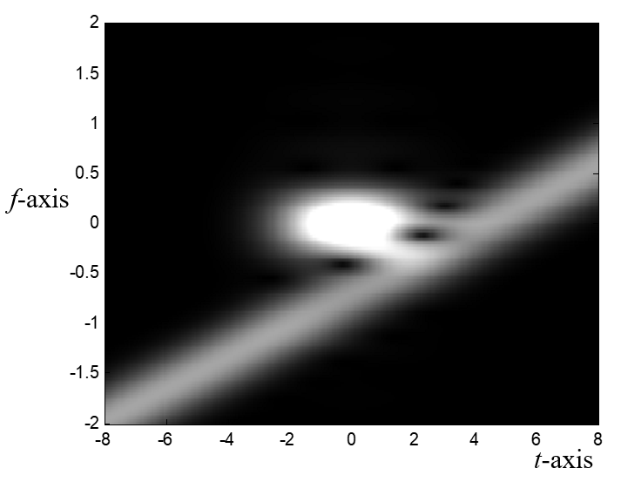
Problem Formulation (1/2)
We can use Fourier Transform to do the filtering in frequency domain.
However, when the time-frequency plot is shown as below, such signal can’t be filtered using Fourier Transform.

Slide 4
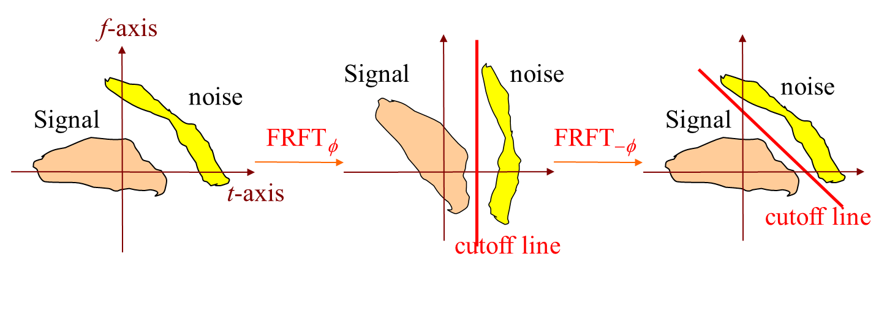
Problem Formulation (2/2)
Our goal is to obtain the clear signal.
We use FrFT to filter out the noise which could not be removed by traditional FFT method.

Slide 5
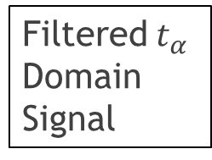
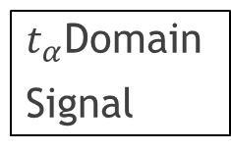
System Block Diagram
Host
Kernel
Host Program
Kernel Function
Input Signal
Kernel Function
(DFrFT)
Input File
Read Signal Samples
$t_{α}$Domain
Signal
Cutoff
Filtered$t_{α}$Domain Signal
Output File
Save to File
Result Signal

Slide 6
Target Spec & Result Summary
Target Spec
Accuracy | Error less than 1%
Clock frequency | 200MHz
Area(Resource) | Be able to run on Zedboard
Latency | As low as possible
Result Summary
Accuracy | Error 1.06%
Timing Constraint | No negative slack
Area(Resource) | Highest Utilization 57% (BRAM)
Latency | 6ms ⟹ 0.3ms (reduce 95%)

Slide 7
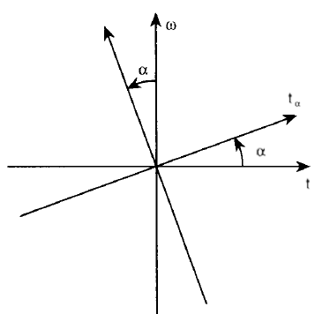
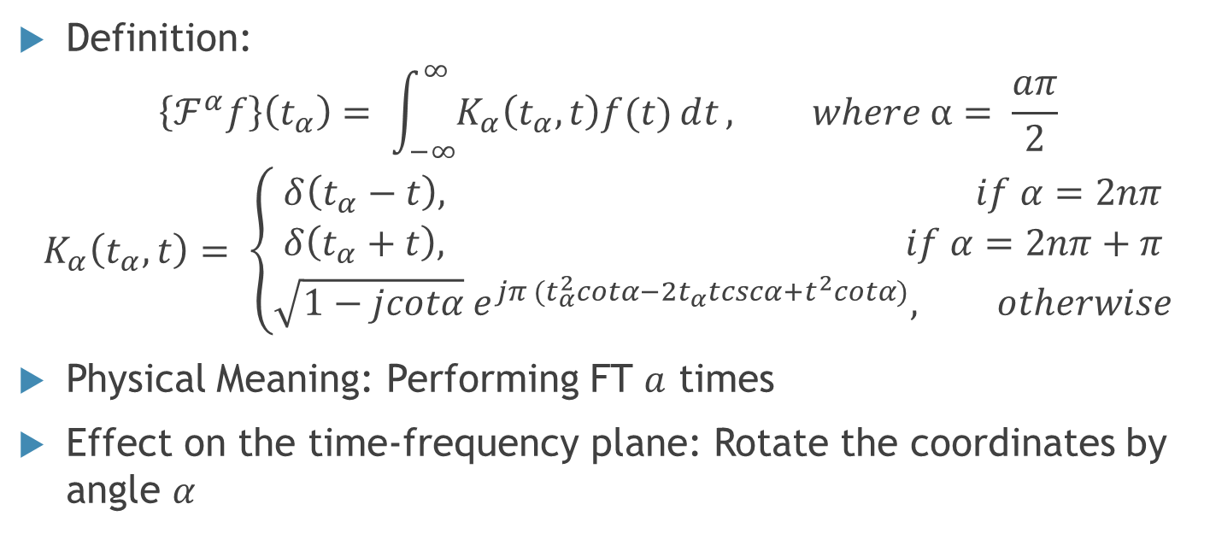
Fractional Fourier Transform (FrFT)
Definition:
$$\left\{ℱ^{α}f\right\}\left(t_{α}\right)= \int_{−∞}^{∞}{K_{α}\left(t_{α},t\right)f(t)ⅆt}, where α= \frac{aπ}{2}$$
$$K_{α}\left(t_{α},t\right)= \left\{\begin{aligned}δ\left(t_{α}−t\right), if α=2nπ \\ δ\left(t_{α}+t\right), if α=2nπ+π \\ \sqrt{1−jcotα}{ e}^{jπ (t_{α}^{2}cotα−{2t}_{α}tcscα+t^{2}cotα)}, otherwise\end{aligned}\right.$$
Physical Meaning: Performing FT $a$ times
Effect on the time-frequency plane: Rotate the coordinates by angle $α$

Slide 8
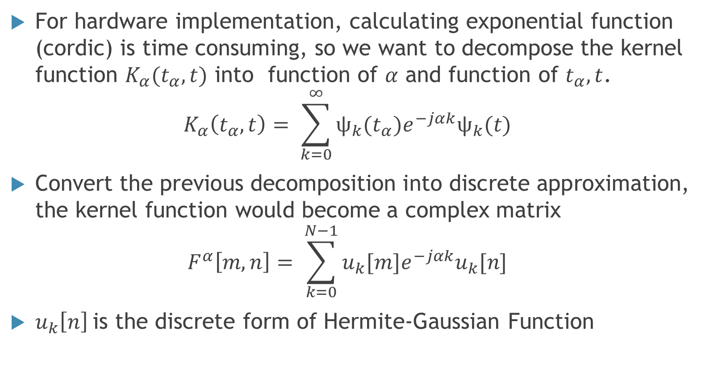
Discrete Fractional Fourier Transform (DFrFT)
For hardware implementation, calculating exponential function (cordic) is time consuming, so we want to decompose the kernel function $K_{α}(t_{α},t)$ into function of $α$ and function of $t_{α},t$.
$$K_{α}\left(t_{α},t\right)= \sum_{k=0}^{∞}{ψ_{k}(t_{α})e^{−jαk}ψ_{k}(t)}$$
Convert the previous decomposition into discrete approximation, the kernel function would become a complex matrix
$$F^{α}\left[m,n\right]= \sum_{k=0}^{N−1}{u_{k}[m]e^{−jαk}u_{k}[n]}$$
$u_{k}\left[n\right]$is the discrete form of Hermite-Gaussian Function

Slide 9
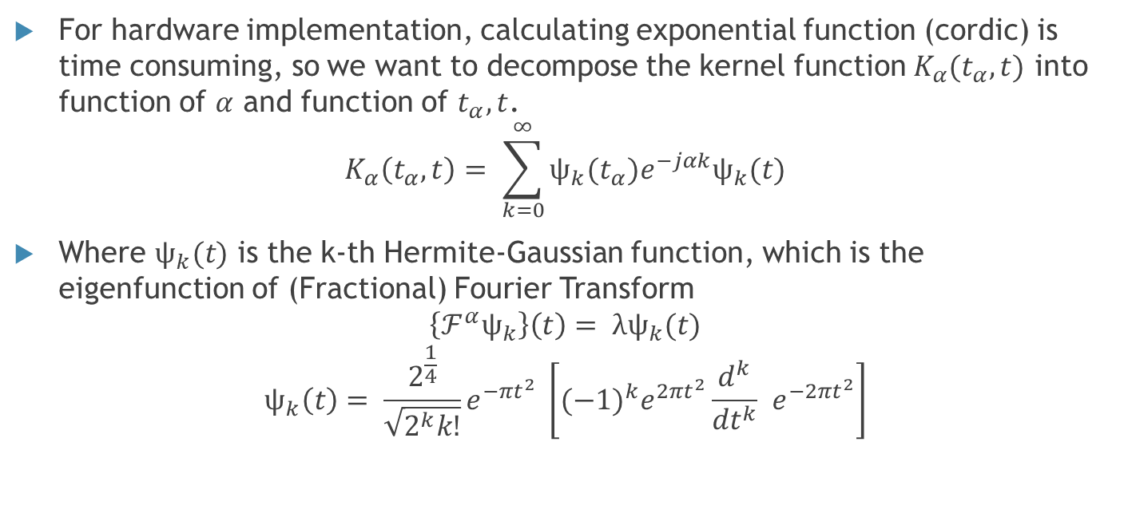
Decompose The Kernel Function
For hardware implementation, calculating exponential function (cordic) is time consuming, so we want to decompose the kernel function $K_{α}(t_{α},t)$ into function of $α$ and function of $t_{α},t$.
$$K_{α}\left(t_{α},t\right)= \sum_{k=0}^{∞}{ψ_{k}(t_{α})e^{−jαk}ψ_{k}(t)}$$
Where $ψ_{k}(t)$ is the k-th Hermite-Gaussian function, which is the eigenfunction of (Fractional) Fourier Transform
$$\left\{ℱ^{α}ψ_{k}\right\}\left(t\right)= λψ_{k}(t)$$
$$ψ_{k}\left(t\right)= \frac{2^{\frac{1}{4}}}{\sqrt{2^{k}k!}}e^{−πt^{2}} \left[{(−1)}^{k}e^{2πt^{2}}\frac{d^{k}}{dt^{k}} e^{−2πt^{2}}\right]$$

Slide 10
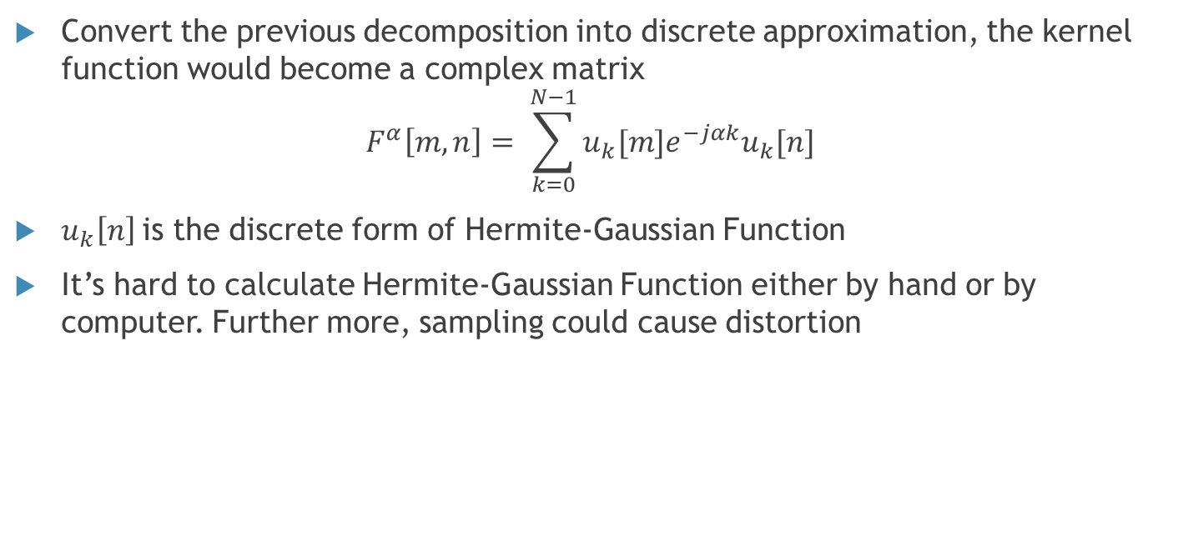
Discrete Fractional Fourier Transform (DFrFT)
Convert the previous decomposition into discrete approximation, the kernel function would become a complex matrix
$$F^{α}\left[m,n\right]= \sum_{k=0}^{N−1}{u_{k}[m]e^{−jαk}u_{k}[n]}$$
$u_{k}\left[n\right]$is the discrete form of Hermite-Gaussian Function
It’s hard to calculate Hermite-Gaussian Function either by hand or by computer. Further more, sampling could cause distortion

Slide 11
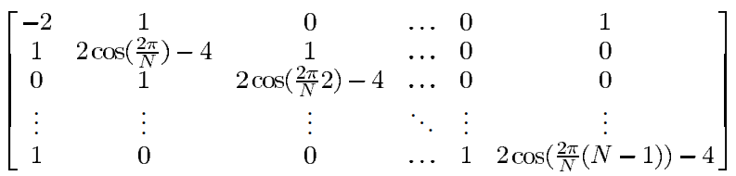
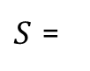
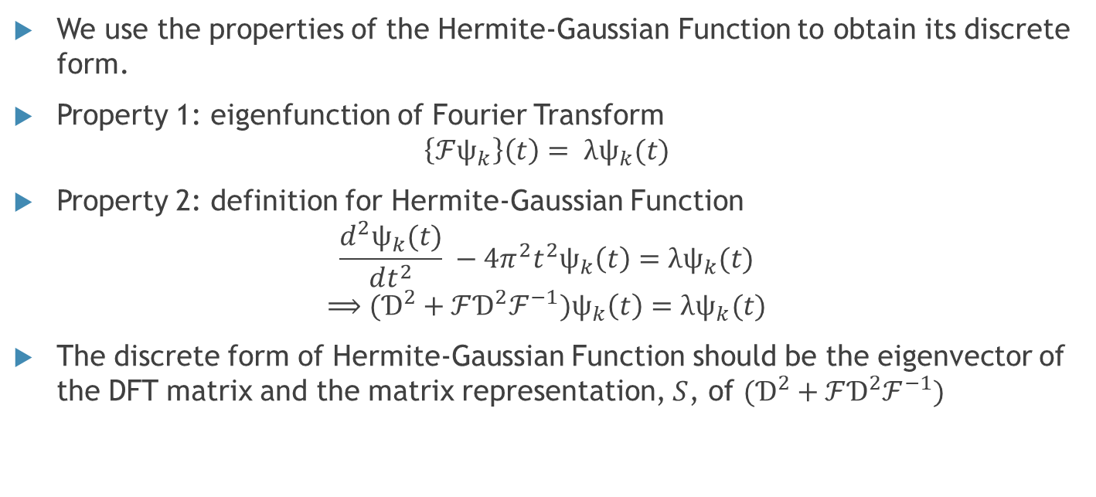
Obtaining The Discrete Form of Hermite-Gaussian Function
We use the properties of the Hermite-Gaussian Function to obtain its discrete form.
Property 1: eigenfunction of Fourier Transform
$$\left\{ℱψ_{k}\right\}\left(t\right)= λψ_{k}(t)$$
Property 2: definition for Hermite-Gaussian Function
$$\frac{d^{2}ψ_{k}(t)}{dt^{2}} −4π^{2}t^{2}ψ_{k}\left(t\right)=λψ_{k}(t)$$
$$⟹(Ɗ^{2}+ℱƊ^{2}ℱ^{−1})ψ_{k}\left(t\right)=λψ_{k}(t)$$
The discrete form of Hermite-Gaussian Function should be the eigenvector of the DFT matrix and the matrix representation, $S$, of $(Ɗ^{2}+ℱƊ^{2}ℱ^{−1})$
$S$ =

Slide 12
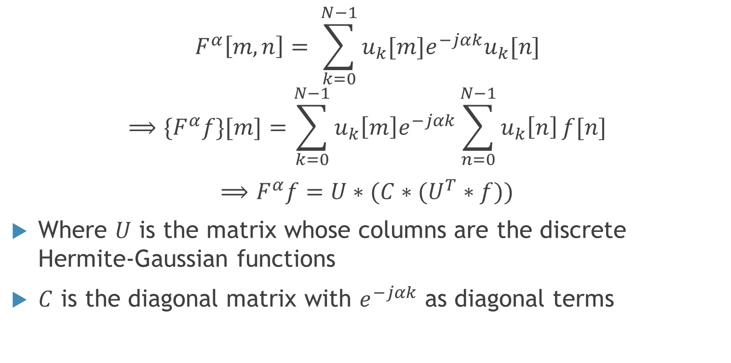
DFrFT Algorithm
$$F^{α}\left[m,n\right]= \sum_{k=0}^{N−1}{u_{k}[m]e^{−jαk}u_{k}[n]}$$
$$⟹{\{F}^{α}f\}[m]=\sum_{k=0}^{N−1}{u_{k}\left[m\right]e^{−jαk}\sum_{n=0}^{N−1}{u_{k}\left[n\right]}f[n]}$$
$⟹$ $F^{α}f=U∗(C∗(U^{T}∗f))$
Where $U$ is the matrix whose columns are the discrete Hermite-Gaussian functions
$C$ is the diagonal matrix with $e^{−jαk}$ as diagonal terms

Slide 13
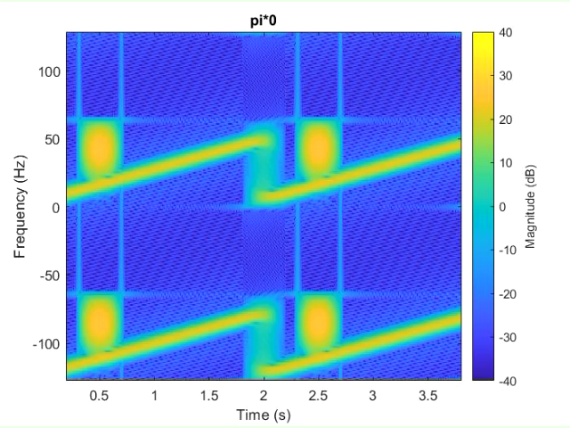
Algorithm Simulation - DFrFT with different rotation angles

Slide 14
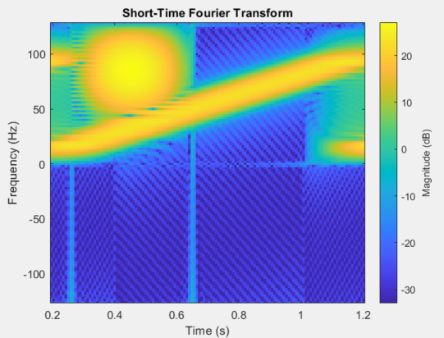
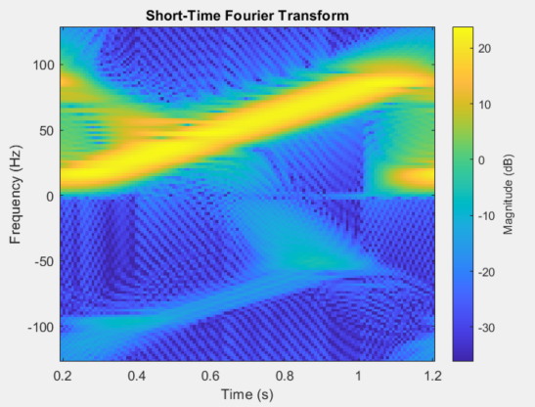
Algorithm Simulation – Denoise by using DFrFT
Chirp is our signal.
Denoise

Slide 15
Code Flow
Input f & Rotation angle α
Twiddle Factor
Map to
Hermite-Gaussian Domain
Phase Shift
Map to
t_{α} Domain
Rotated input f

Slide 16
HLS Optimization (1)
Use bundle for AXI-Master
Real, Imag
Real
Imag

Slide 17
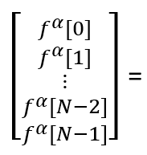
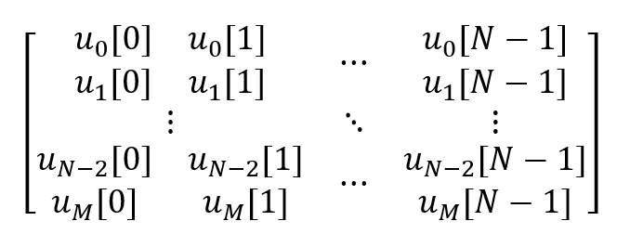
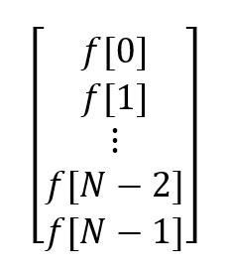
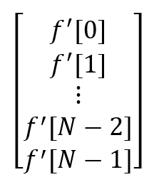
HLS Optimization (2)
Change the method of calculating matrix multiplication and use unroll 8.

Slide 18
HLS Optimization (3)
Use dataflow for parallel computing of “map to Hermite-Gaussian Domain” and “Twiddle Factor”
Input f
Rotation angle α
Map to
Hermite-Gaussian Domain
Twiddle Factor
Phase Shift
Map to
t_{α} Domain
Rotated input f

Slide 19
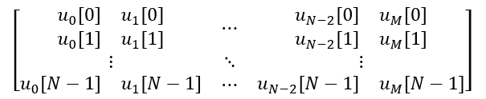
HLS Optimization (4)
Twiddle Factor

Slide 20
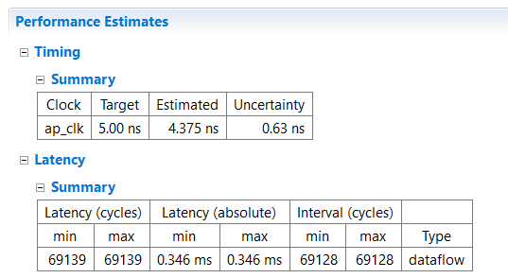
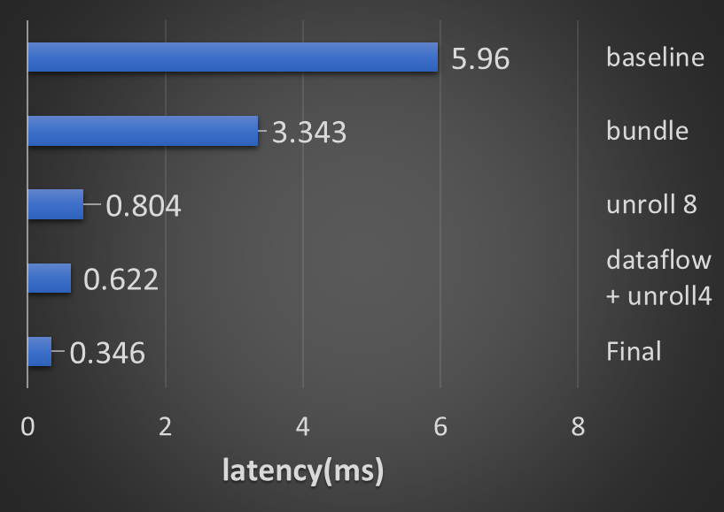
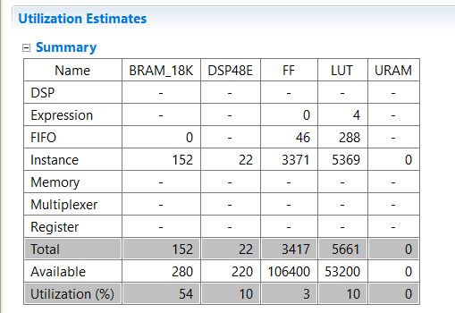
HLS Optimization - Summary
Improvement

Slide 21
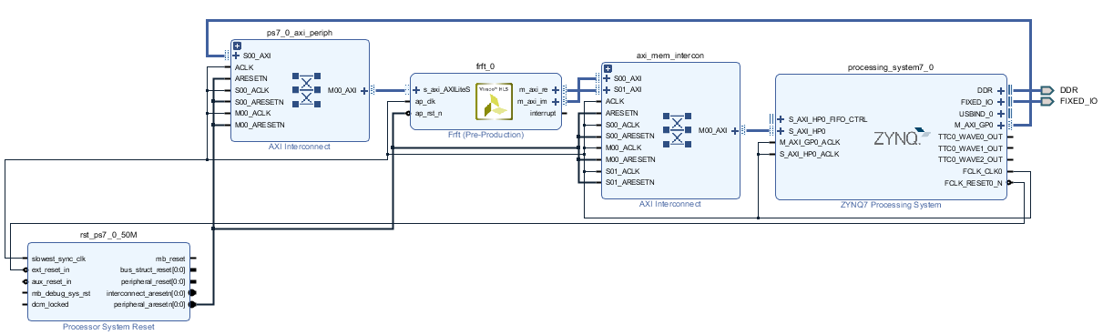
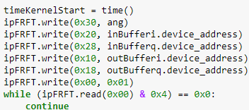
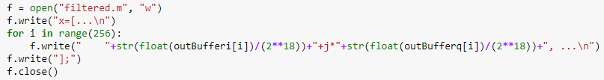
Bring up PYNQ System (1)

Slide 22
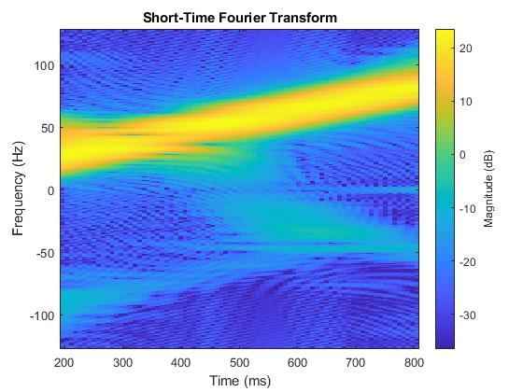
Bring up PYNQ System (2)
Algorithm Simulation
Implementation Result

Slide 23
Conclusion
The filtered result has similar (or even better) performance as software simulation.
The latency of the 256-point DFrFT kernel is 0.3ms; on the other hand, sample rate of audio signals is usually 44100Hz.
Which means the DFrFT kernel as well as the filtering function could reach real-time performance.

Slide 24
Thanks for listening!!!

